Slide 1
An Operating System Kernel Frame Allocator in Rust
November 30, 2022

Slide 2
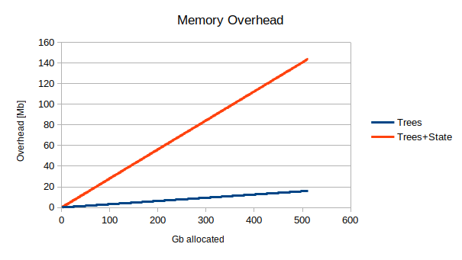
Allocator Memory Overhead (Old)
Additional data structures:
tree 4Kb
tree 2Mb
tree 1Gb
State array
biggest structure:
size ≃ 1/4*NB_GB Mb
Represents ~0.03% overhead

Slide 3
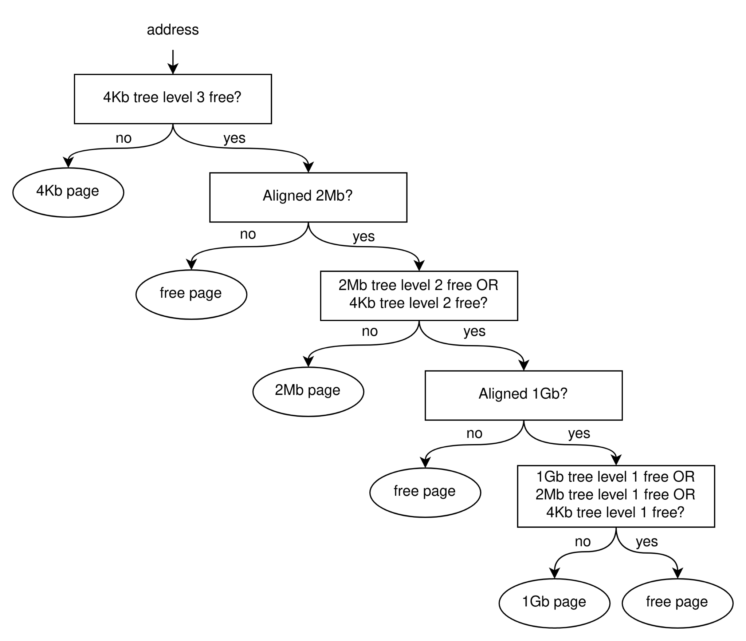
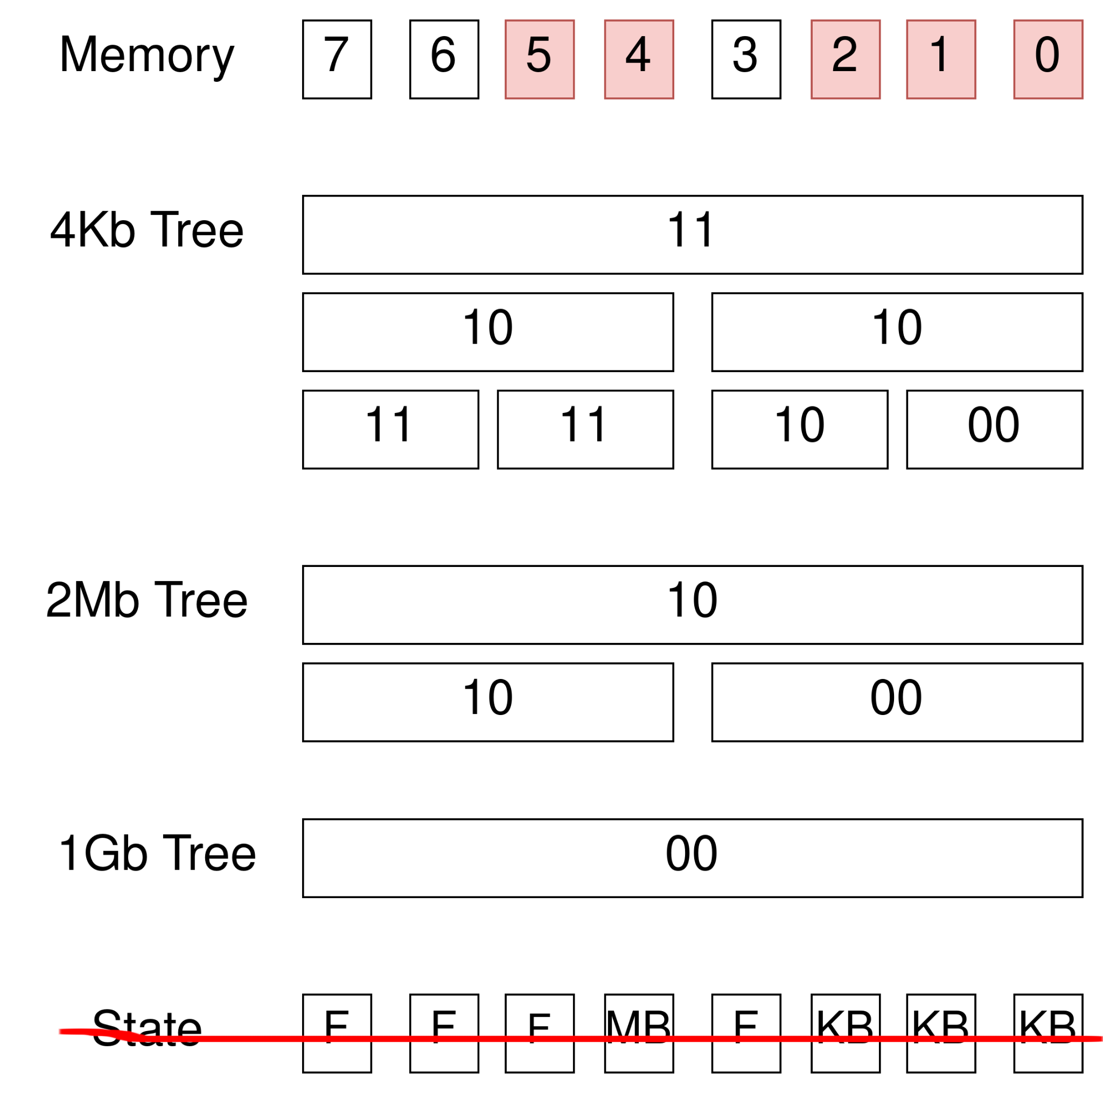
Buddy Allocator
Binary tree for simplification

Slide 4
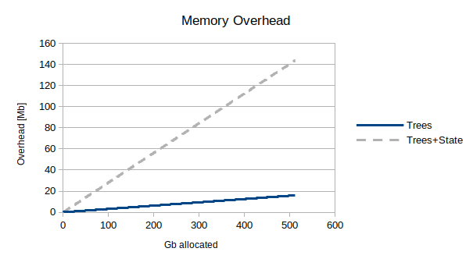
Allocator New Memory Overhead
Additional data structures:
tree 4Kb
tree 2Mb
tree 1Gb
size ≃ 0.04*NB_GB Mb
Represents ~0.004% overhead

Slide 5
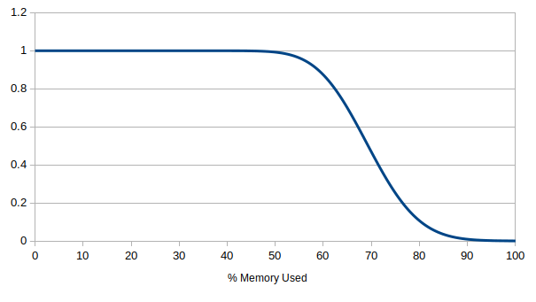
Benchmark Setup
Inverse cumulative poisson distribution
Random remove of allocated frames
⅓ memory allocated to each size
512 Gb used
2 billion frames allocated
Probability To Allocate A Frame

Slide 6
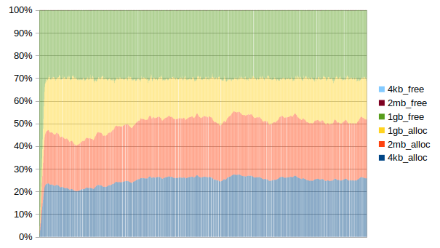
In A Perfect World
70% Memory Used, No Internal Fragmentation

Slide 7
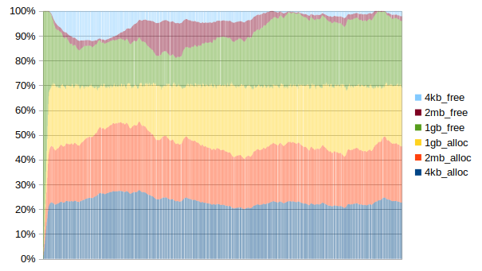
Results
70% Memory Used

Slide 8
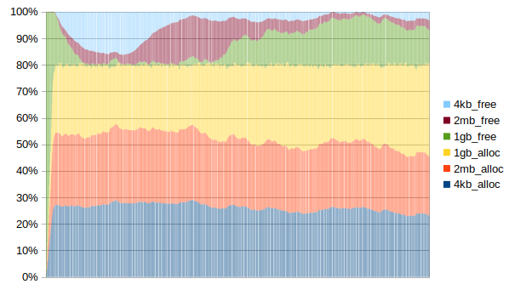
Results
80% Memory Used

Slide 9
Internal Fragmentation Minimization
Inverse search order for 2Mb blocks at last level
No improvement noted

